Slide 1
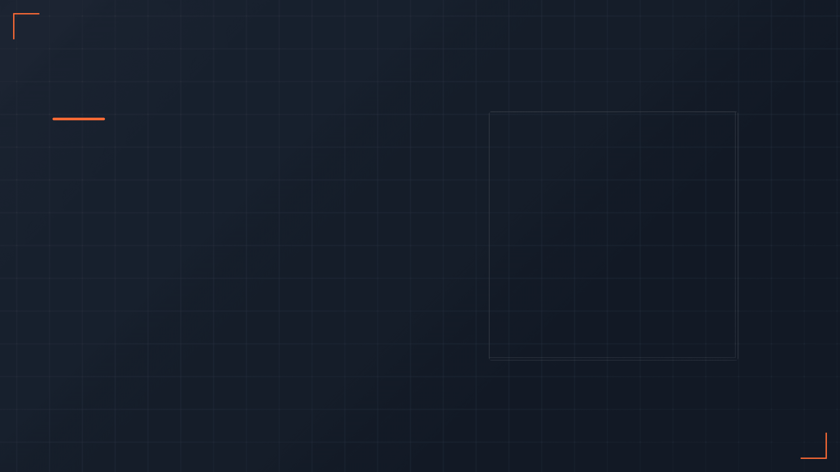
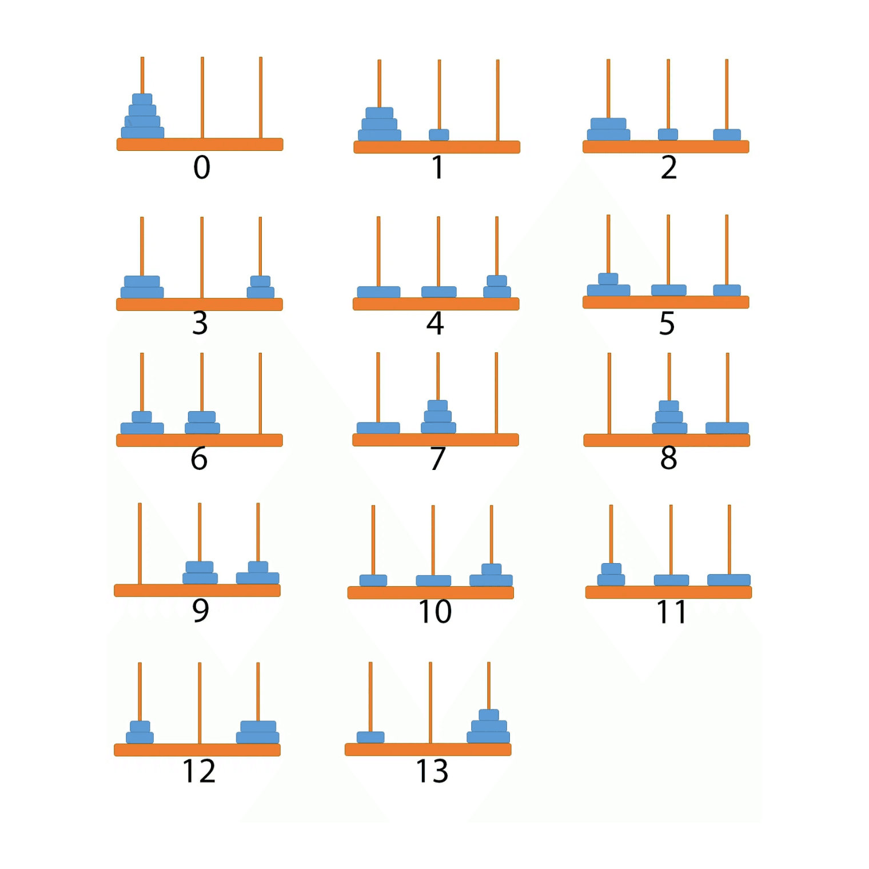
The Tower of Hanoi
A Classic Recursive Algorithm
Understanding the Problem, Solution, and Complexity

Slide 2
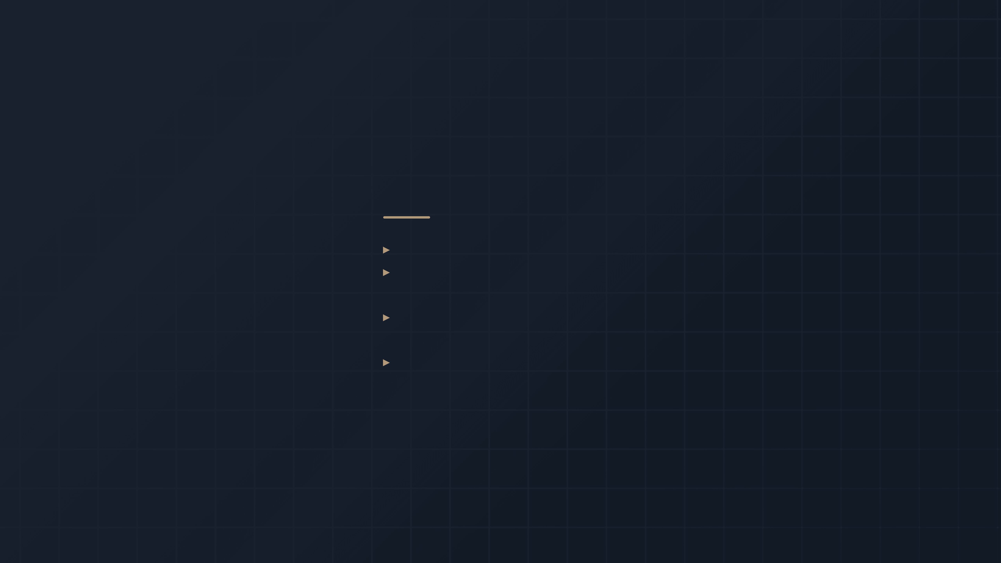
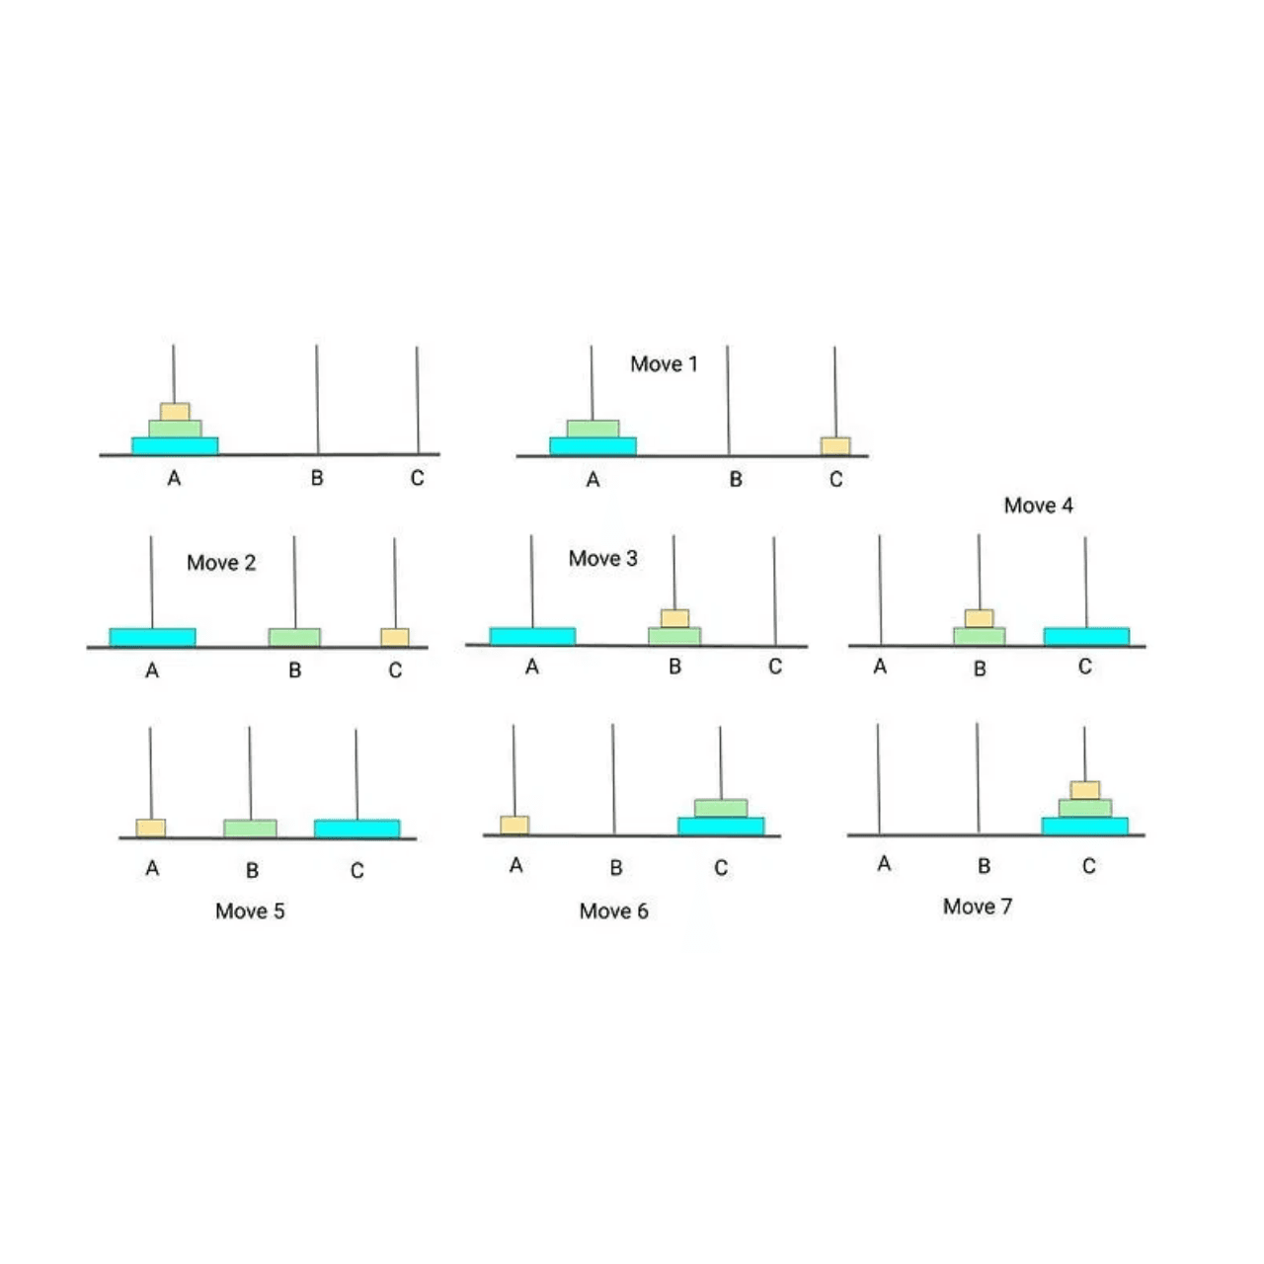
What is the Tower of Hanoi?
▸
A mathematical puzzle invented by
Édouard Lucas
in
1883
▸
that can slide onto any peg
Consists of
three pegs
(or rods) and a number of
disks of different sizes
▸
on one peg, with the smallest disk at the top
The puzzle starts with all disks stacked in
ascending order of size
▸
Move the entire stack from the source peg to a destination peg, following specific rules
Objective:

Slide 3
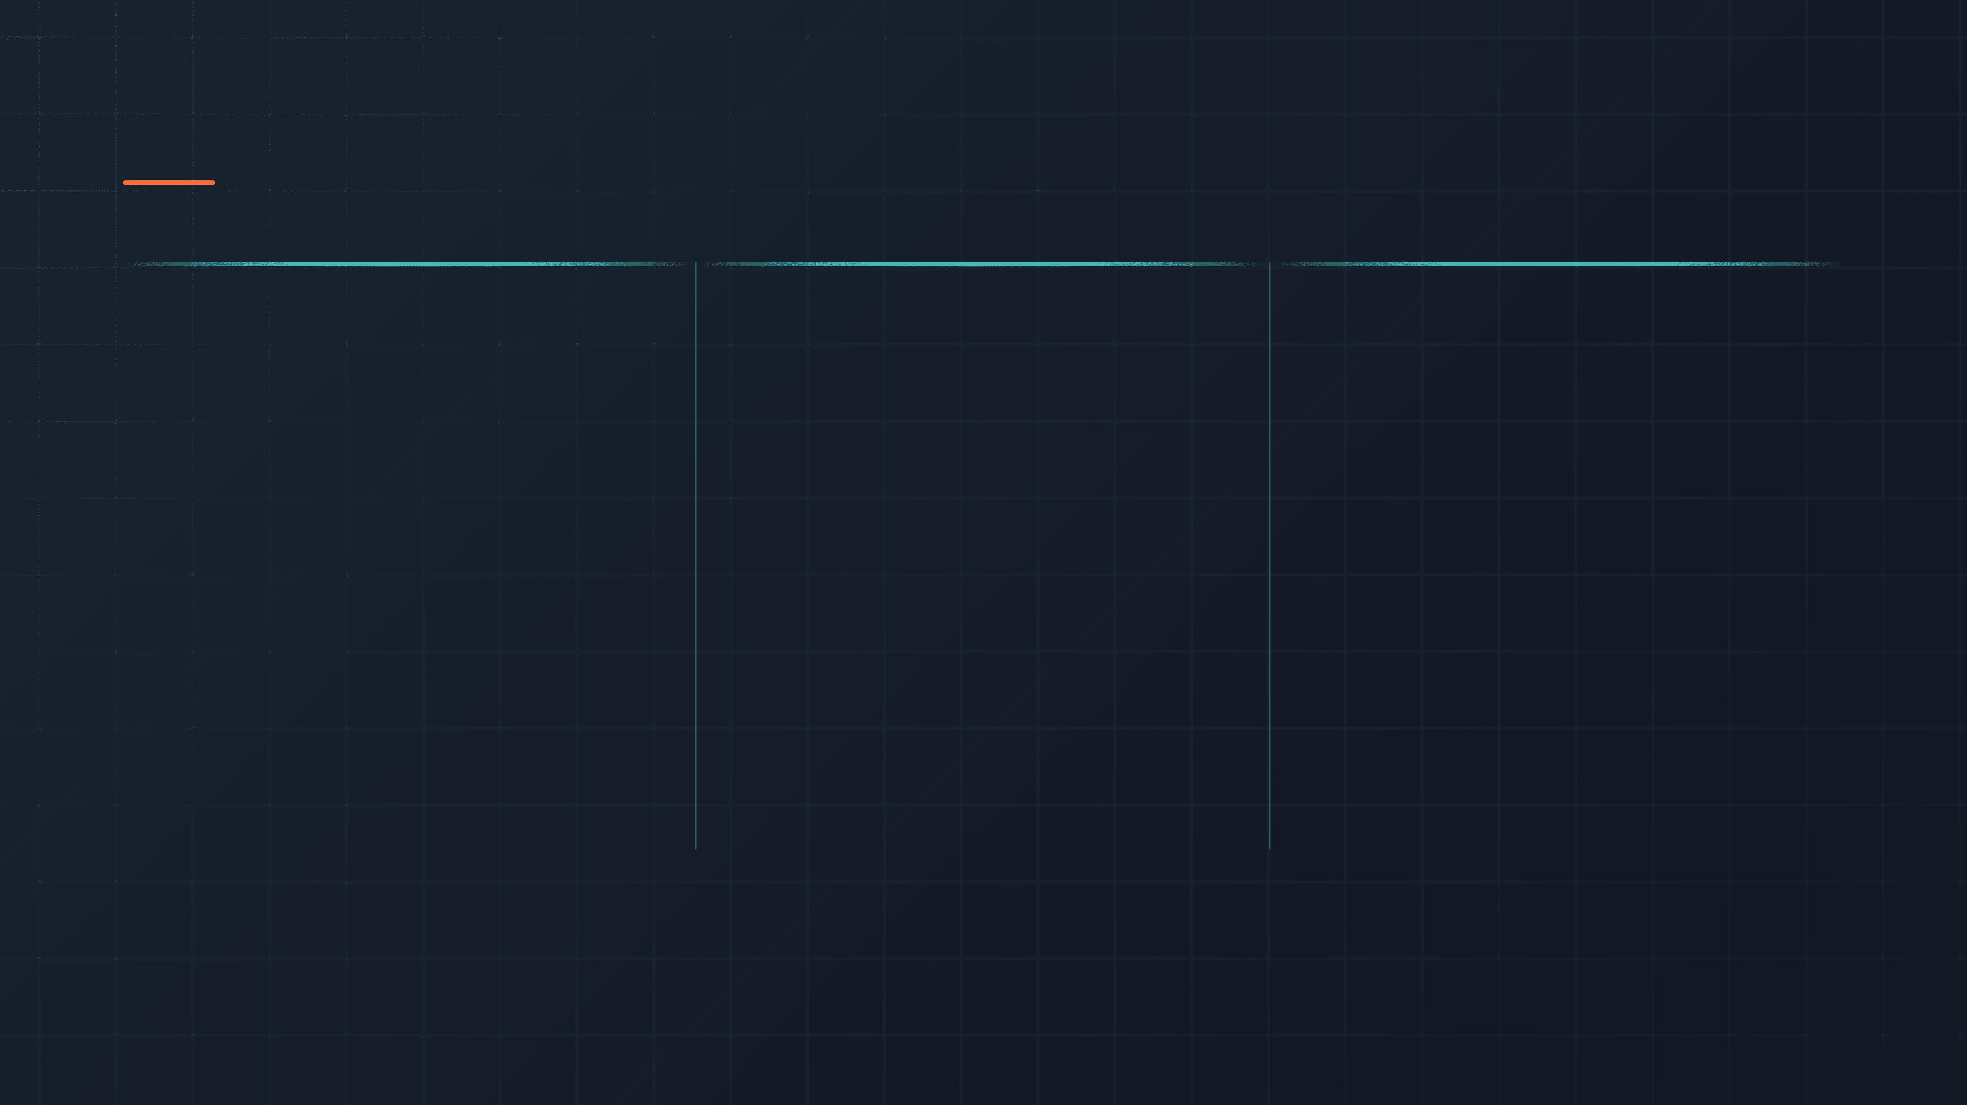
The Three Fundamental Rules
01
02
03
⊙
↑
✕
Move One Disk
Top Disk Only
No Larger on Smaller
Only one disk can be moved at a time. This constraint ensures the puzzle remains challenging and forces a systematic approach to the solution.
A move consists of taking the upper disk from one of the stacks and placing it on top of another stack or on an empty peg.
No disk may be placed on top of a smaller disk. This rule prevents invalid configurations and guides the solution path.

Slide 4
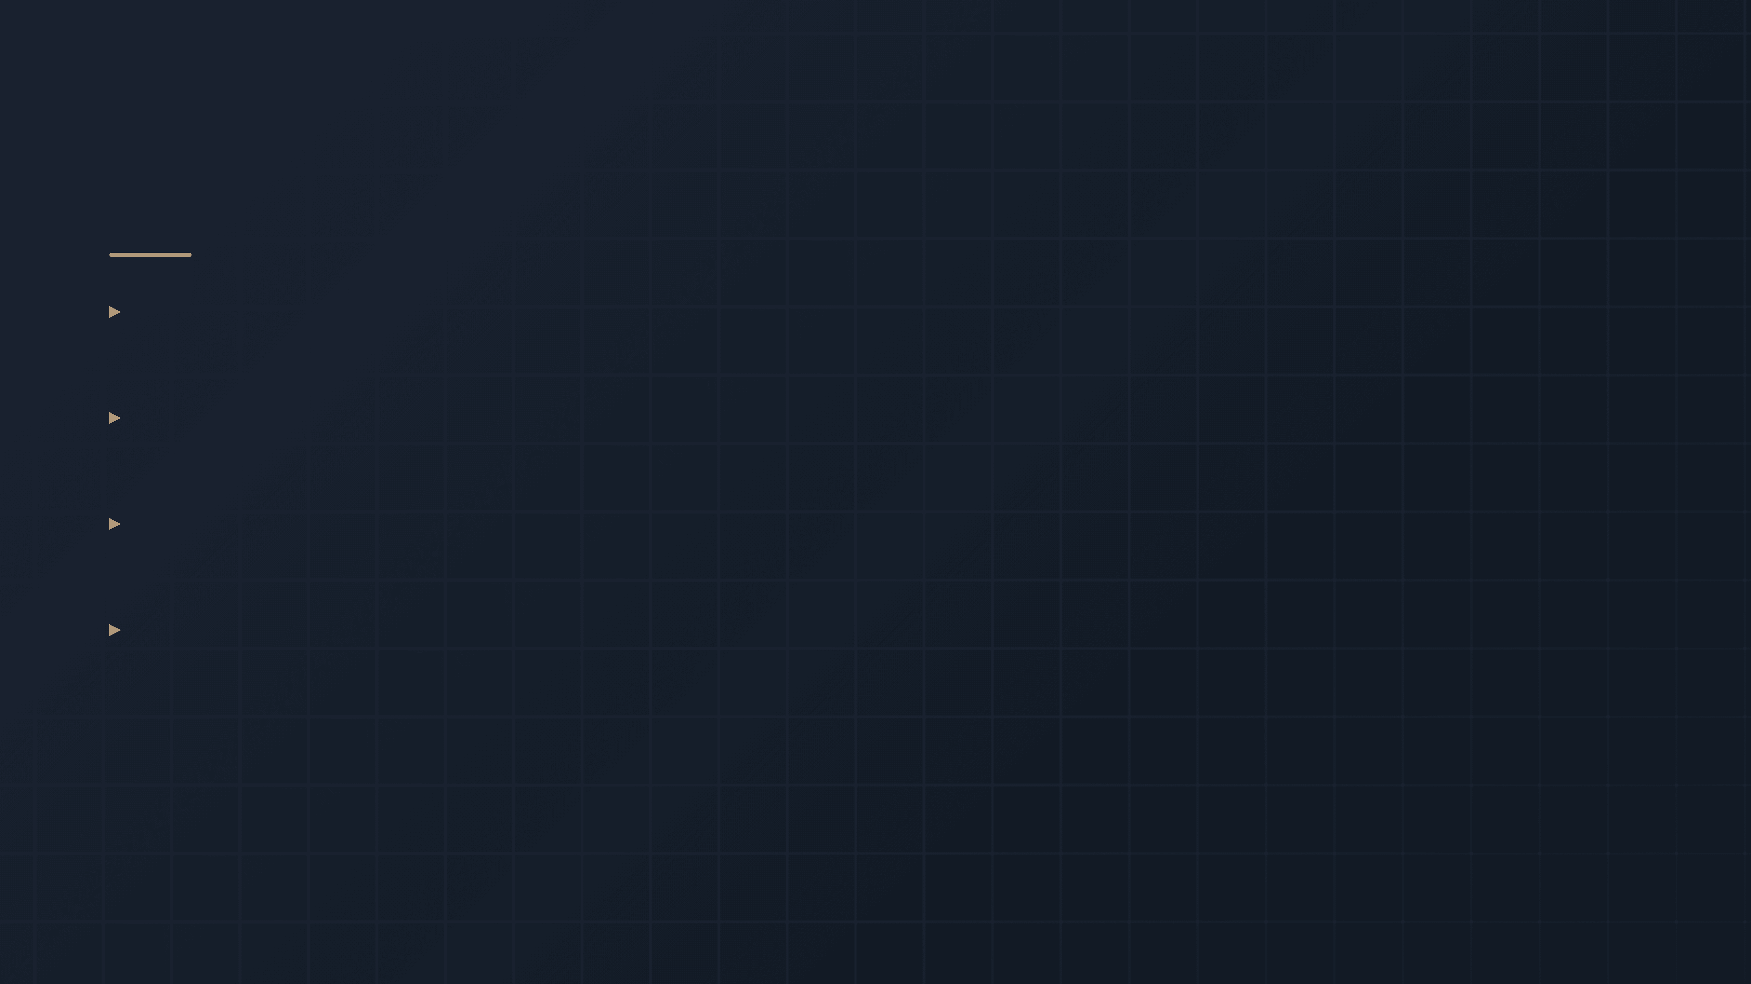
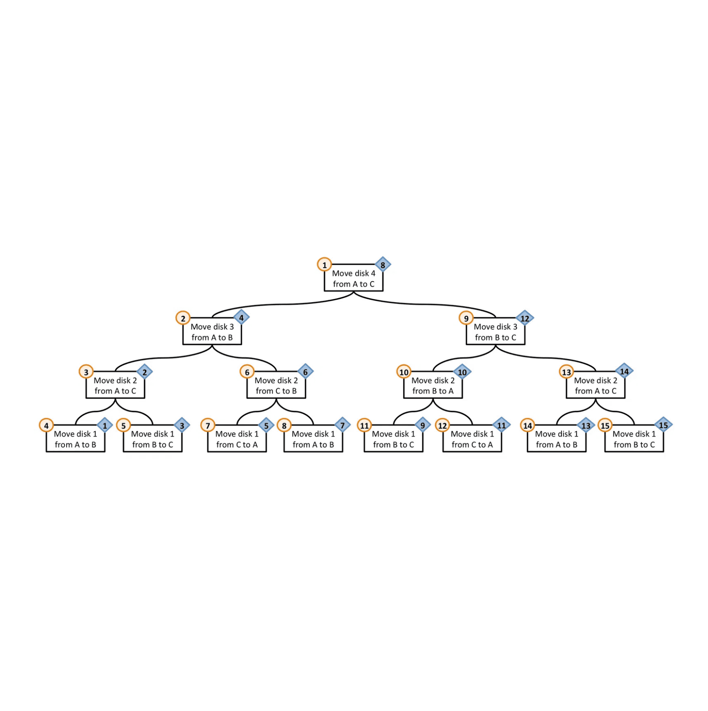
The Power of Recursion
▸
of a problem solved efficiently using
The Tower of Hanoi is a
perfect example
recursion
▸
two smaller, identical problems
The problem for
N disks
is broken down into
for
N-1 disks
▸
This recursive decomposition allows us to solve a complex problem by solving simpler versions of the same problem
▸
If there is only one disk (N=1), move it directly from the source to the destination
Base Case:
Solve(N) = Solve(N-1) + Move(N) + Solve(N-1)

Slide 5

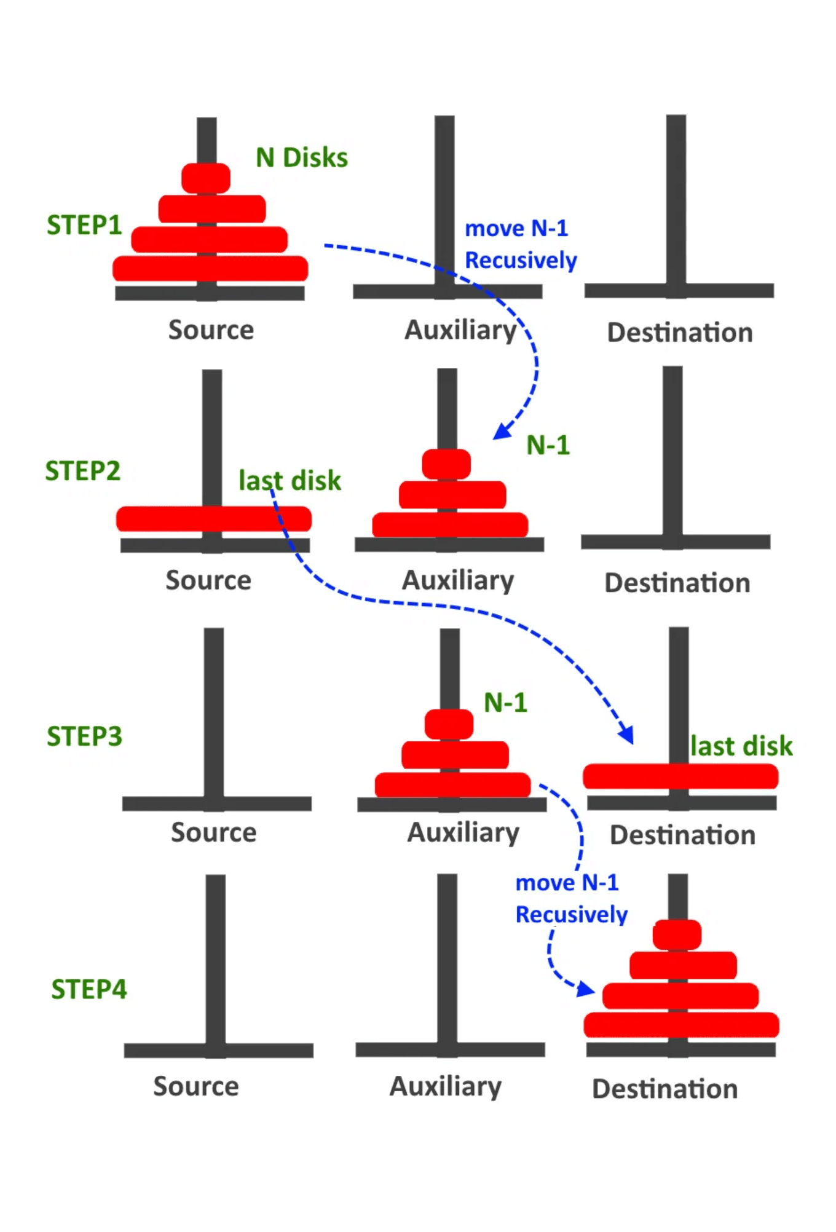
The Three-Step Recursive Algorithm
Step 1
Move N-1 Disks to Auxiliary
Move the top N-1 disks from the Source peg to the Auxiliary peg, using the Destination peg as a temporary holding area. This is a recursive call to solve the problem for N-1 disks.
Step 2
Move the Largest Disk
Move the largest disk (disk N) directly from the Source peg to the Destination peg. This is the only time this disk moves, and it can only happen when all smaller disks are out of the way.
Step 3
Move N-1 Disks to Destination
Move the N-1 disks from the Auxiliary peg to the Destination peg, using the Source peg as a temporary holding area. This completes the recursive solution.

Slide 6

Algorithm Pseudocode and Implementation
functionHanoi(N, Source, Destination, Auxiliary):
if N == 1:
Move disk 1 fromSourcetoDestination
return
// Step 1: Move N-1 disks from Source to Auxiliary
Hanoi(N-1, Source, Auxiliary, Destination)
// Step 2: Move the largest disk from Source to Destination
Move disk N fromSourcetoDestination
// Step 3: Move N-1 disks from Auxiliary to Destination
Hanoi(N-1, Auxiliary, Destination, Source)

Slide 7
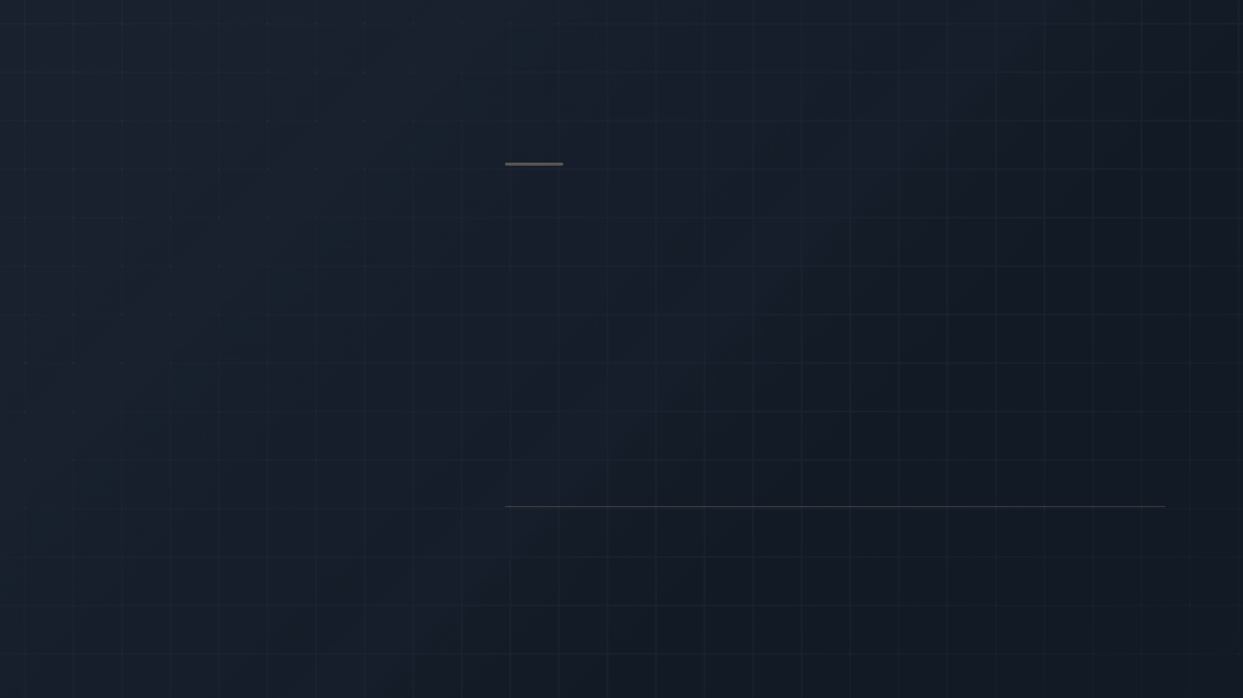
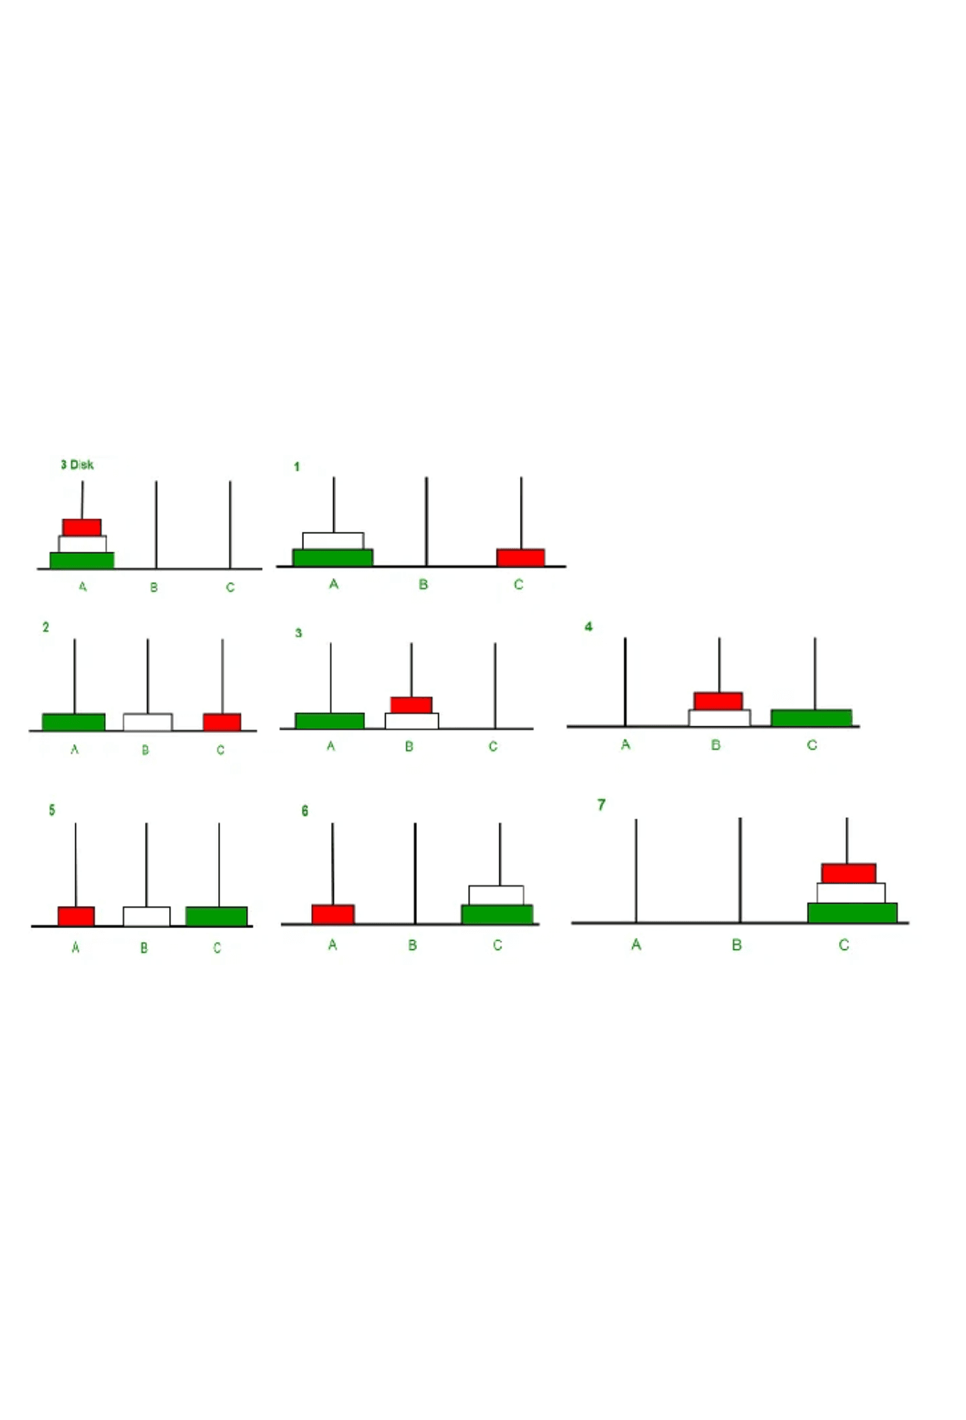
Example Walkthrough: N = 3 Disks
Goal
Move 3 disks from Peg A (Source) to Peg C (Destination), using Peg B (Auxiliary)
1
Move 2 Disks (Recursive)
Move the top 2 disks from A to B, using C as the temporary peg
2
Move Largest Disk
Move disk 3 (the largest) from A to C
3
Move 2 Disks (Recursive)
Move the 2 disks from B to C, using A as the temporary peg
Total Moves Required
2³ − 1 = 7

Slide 8
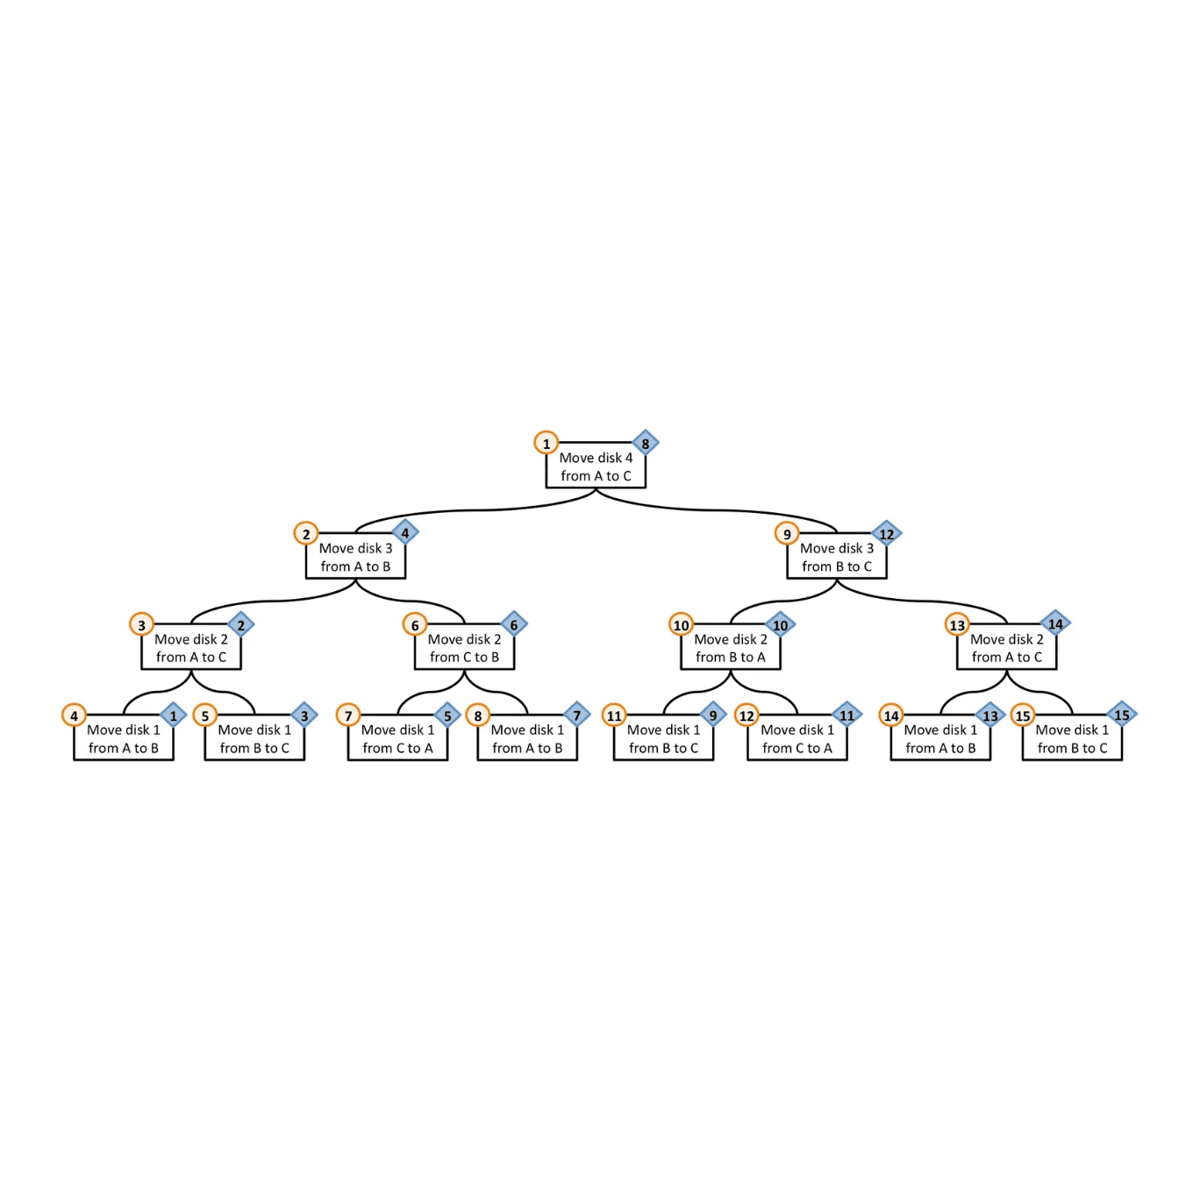
Time Complexity Analysis
Problem Definition
Let T(N) be the number of moves required to solve the Tower of Hanoi puzzle with N disks.
Recurrence Relation
From the three-step algorithm:
T(N) = T(N-1) + 1 + T(N-1)
Simplifies to:
T(N) = 2·T(N-1) + 1
This recurrence relation captures the structure of the recursive algorithm: two recursive calls for N-1 disks plus one move for the largest disk.

Slide 9
Time Complexity: Solution and Formula
Base Case
T(1) = 1
With one disk, only one move is needed to transfer it to the destination.
Solution Formula
T(N) = 2N − 1
This formula represents the minimum number of moves required to solve the Tower of Hanoi puzzle for N disks. The solution is derived by solving the recurrence relation T(N) = 2·T(N-1) + 1 with the base case T(1) = 1.
Complexity Class
The time complexity of the Tower of Hanoi algorithm is
O(2
N
)
, which is
exponential
. This means the number of operations grows exponentially
with the input size, making the problem computationally infeasible for large values of N.

Slide 10
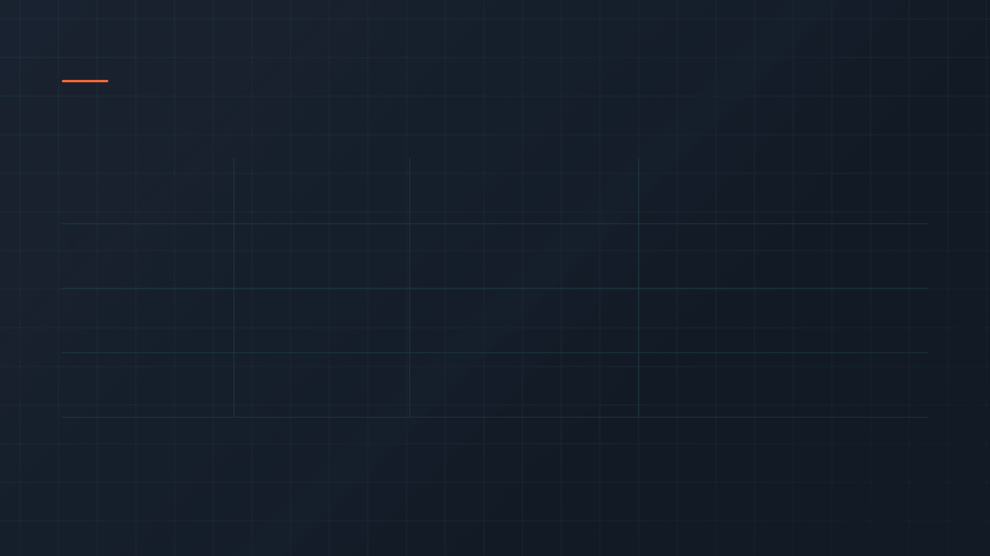
The Exponential Nature of the Solution
The complexity of the Tower of Hanoi solution is
O(2
N
)
, which is
exponential
. This means the number of moves
doubles with each additional disk
, leading to
dramatically increasing computational requirements.
Disks (N)
Formula
Total Moves
Time (1 move/sec)
3
2³ − 1
7
7 seconds
10
2¹⁰ − 1
1,023
~17 minutes
20
2²⁰ − 1
1,048,575
~12 days
30
2³⁰ − 1
1.07B
~34 years
40
2⁴⁰ − 1
1.10T
~34,900 years
50
2⁵⁰ − 1
1.13Q
~35.7M years
64
2⁶⁴ − 1
18.4Q
~585B years
The Legend of the Tower of Hanoi
According to legend, monks in a temple are solving the Tower of Hanoi puzzle with 64 golden disks. When they complete it, the world will end. With 264 − 1 moves required and assuming one move per second, it would take approximately 585 billion years—far longer than the universe's current age of 13.8 billion years.

Slide 11
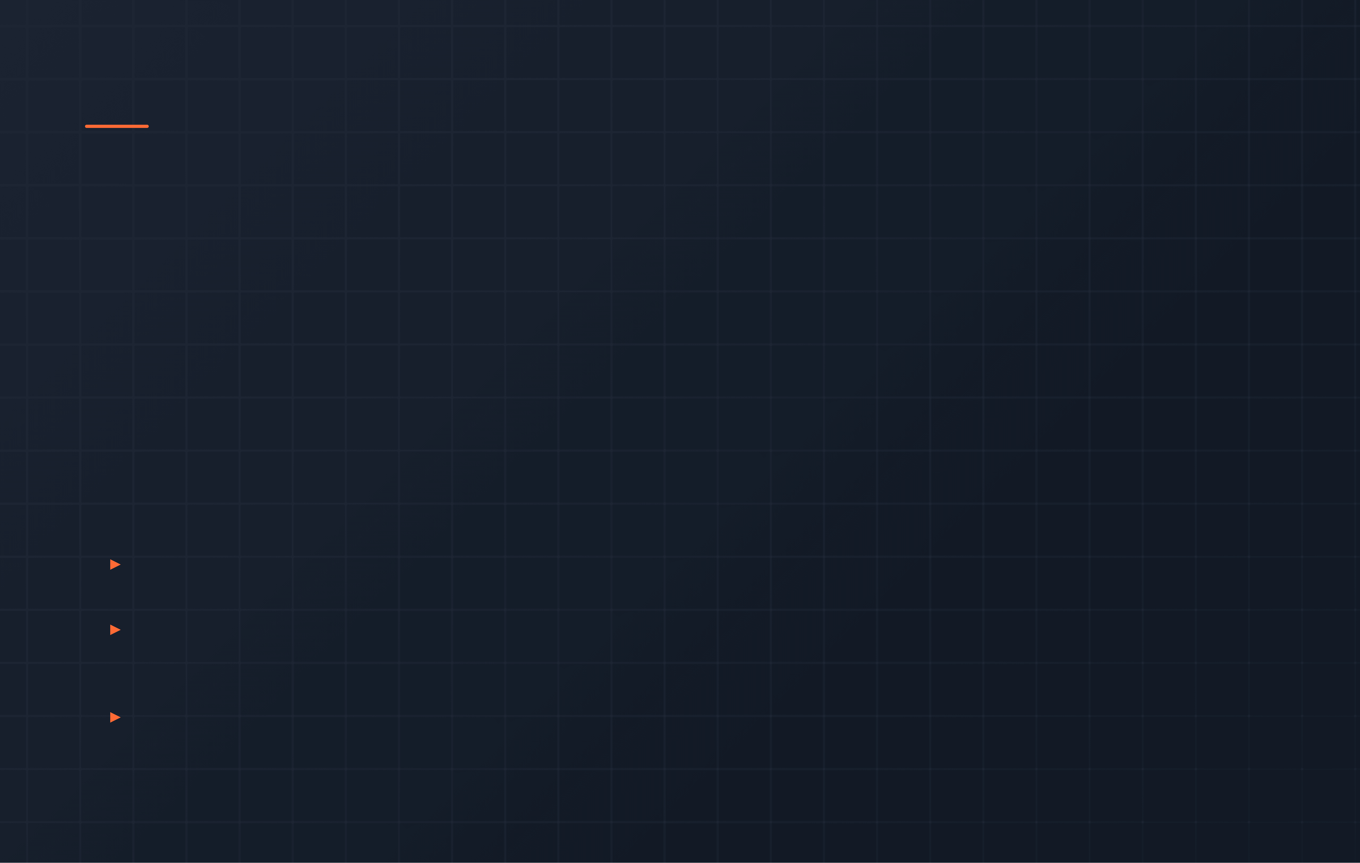
Summary and Real-World Applications
Key Takeaways
01
02
03
Recursive Solution: The Tower of Hanoi demonstrates elegant recursive problem-solving by breaking down an N-disk problem into N-1 disk subproblems.
Exponential Complexity:
The minimum
Algorithmic Power: The algorithm showcases the elegance and power of recursive problem-solving in computer science.
number of moves is
2
N
− 1
, demonstrating
exponential growth and the practical limits of
brute-force solutions.
Real-World Applications
▸
Computer Science Education
The Tower of Hanoi is a fundamental teaching tool for understanding recursion, function calls, and the call stack in introductory computer science courses.
▸
State-Space Search and Optimization
The puzzle provides a simple yet powerful model for understanding state-space search algorithms, backtracking, and optimization problems in artificial intelligence.
▸
Gray Code and Data Backup
The underlying logic of the Tower of Hanoi solution is relevant to Gray Code generation and certain types of incremental data backup procedures that minimize changes between states.

